Slide 1
ACCOUNTING INFORMATION MĀORI BUSINESSES
2021
WEEK EIGHT
115.112

Slide 2
Key questions
What is the intergenerational challenge that Māori/Iwi Businesses must address?
How does accounting information contribute to the success of Māori/Iwi Businesses.
How does the Integrated Development Agenda contribute to the success of Māori/Iwi Businesses
Emergence of Integrated Reporting Framework.

Slide 3
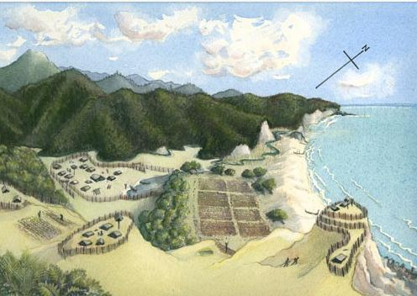
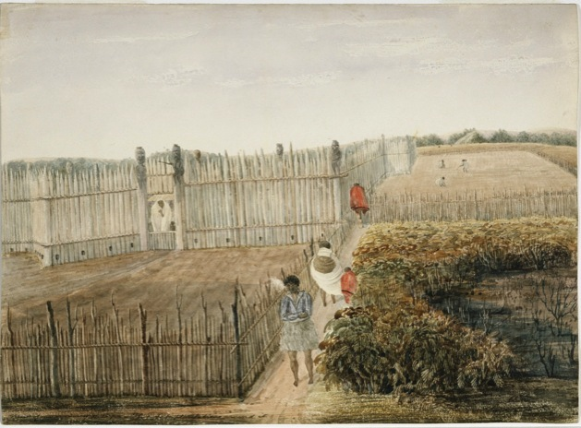
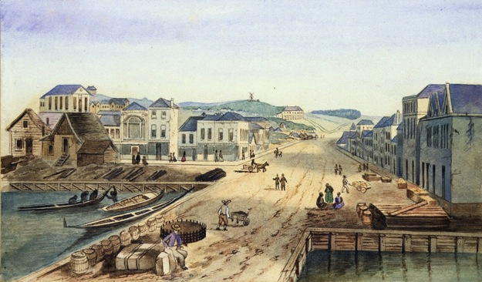
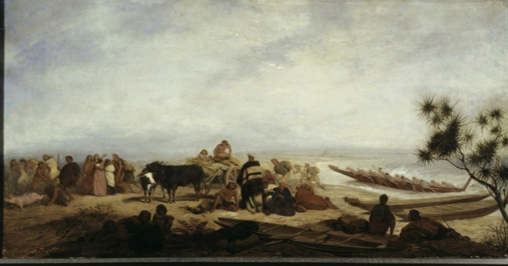
Our past .... Colonisation
Notes:
From the time of Captain Cook’s arrival in New Zealand, Maori demonstrated eagerness to trade and considerable enterprise. Anne Salmond has suggested that a number of specialist traders were located around the Cook Strait area, acting as middlemen in the exchange of South Island for North Island products, and that European goods such as nails offered them exciting new opportunities.
Opportunities for export were avidly pursued by tribal leaders who travelled overseas seeking diplomatic and trading alliances with monarchs, governors, and merchants

Slide 4
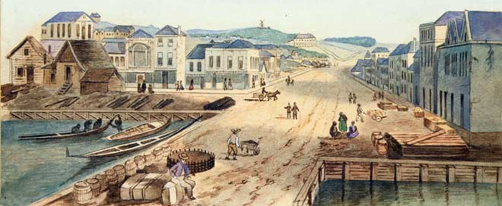
Maori Canoes , Auckland Wharf 1840 - 1860
Notes:
Māori traders can be seen on the right of Queen Street wharf and in the canoe to the left. Māori arrived in Auckland by canoe with goods for trade. Later, they used and owned coastal vessels to transport their goods to the Auckland market.
Reference
Basil Keane, 'Te Māori i te ohanga – Māori in the economy - Māori enterprise, 1840 to 1860', Te Ara - the Encyclopedia of New Zealand ://www.TeAra.govt.nz/en/artwork/25767/maori-canoes-auckland-wharf (accessed 24 April 2021) Story by Basil Keane, published 11 Mar 2010

Slide 5
MAORI TRADING COMMENCES
1805 Bay of Islands:
`Te Pahi became the first influential Maori leader to visit New South `Wales, expressing keen interest in cultural and technological exchange and welcoming Governor King’s plan to settle a party of official observers under his protection at the Bay of Islands. His son, Matara, met George III on a visit to England shortly after.
1820 Hongi Hika was introduced to George IV as was Te Pehi about five years later. Others sent gifts to reigning monarchs.
This was a Maori response to the new environment, seeking alliances with leaders and communities perceived to have the greatest power internationally
They were concerned by rumours that France had designs on New Zealand
Notes:
1805 Bay of Islands
In 1805, Te Pahi became the first influential Maori leader to visit New South Wales, expressing keen interest in cultural and technological exchange and welcoming Governor King’s plan to settle a party of official observers under his protection at the Bay of Islands. His son, Matara, met George III on a visit to England shortly after.
1820
In 1820, Hongi Hika was introduced to George IV as was Te Pehi about five years later. Others sent gifts to reigning monarchs. This was a Maori response to the new environment, seeking alliances with leaders and communities perceived to have the greatest power internationally
Their economy was flourishing, but, in the face of commercial success, Maori also perceived the need for protection under international law. In 1830, the Hokianga-built ship, Sir George Murray, with chiefs Patuone and Taonui on board, was seized in Sydney for not flying a national flag.
They were also concerned by rumours that France had designs on New Zealand, which

Slide 6
Golden age of Māori 1840-1860
The period between 1840 and Maori has been described as the golden age of Maori Enterprise.
Māori Flour Mills built through Waikato, Taranaki, Whanganui, Rotorua and Wairarapa
Māori Shipping From 1840 a number of tribes began buying vessels to transport to European town,
1863 -1864 Trade came to a halt for many tribes/iwi in 1863 and 1864 due to the New Zealand Wards. Between the colonial forces and Māori tribes.
Notes:
The period between 1840 and 1860 has been described as the golden age of Māori enterprise. Māori were the key producers and suppliers of agricultural produce to the towns that began to spring up. They invested in agricultural implements, flour mills and coastal vessels, and produced, processed and transported produce to markets.
Flour mills
Flour mills were a heavy capital investment for tribes. In the 1840s and 1850s mills were built through Waikato, Taranaki, Whanganui, Rotorua and Wairarapa. In Waikato around 50 were built during this period
Māori shipping
From the 1840s a number of tribes began buying vessels to transport produce to European towns. Tribes from the Bay of Islands, Hauraki, Bay of Plenty, East Coast and Poverty Bay all purchased ships. Most were 10 to 20 tonnes and were suited to shorter trips. In 1858 in Auckland Province, 51 ships were registered and 36 vessels were licensed to Māori.
Market crash
In 1855–56 the price in Australia for wheat and potatoes dropped by at least half. By 1859 wheat exports to Australia had ended altogether. Many tribal agricultural enterprises also suffered as soils were exhausted.
Trade came to a halt for many iwi in 1863 and 1864 due to the New Zealand land wars, fought between colonial forces and Māori tribes. A number of Māori-controlled ports were blockaded by government forces. In the 1860s the Māori economy went into headlong decline.

Slide 7
WHAT IS THE TREATY OF WAITANGI
The Treaty of Waitangi (Te Tiriti) is a formal agreement, made in the interest of partnership between Māori chiefs and the British Crown signed in 1840.
Te Tiriti affirmed, and committed to upholding, the mana (authority), tino rangatiratanga (sovereignty), and tikanga (laws) of Māori – recognising the system of laws that had existed prior to the arrival of colonial settlers for representatives of the British Crown,
However, Te Tiriti detailed the cessation of sovereignty by Māori over Aotearoa New Zealand to Queen Victoria.
Notes:
In 1840, the relationship between Maori and the British was further strengthened when over 500 Maori signed the Treaty of Waitangi, a formal alliance with Queen Victoria, under which Britain would have kawanatanga (governance: administration and law) of New Zealand and Maori retain their rangatiratanga (chieftainship). Maori understood the arrangement to be one of partnership, reciprocal obligation, and mutual benefit with the guarantee of rangatiratanga ensuring autonomy over their own affairs.

Slide 8
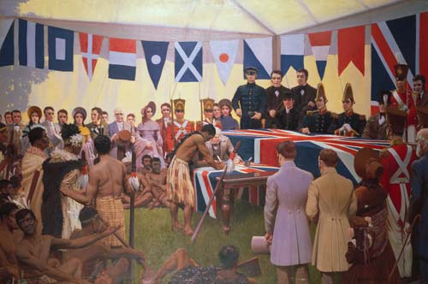
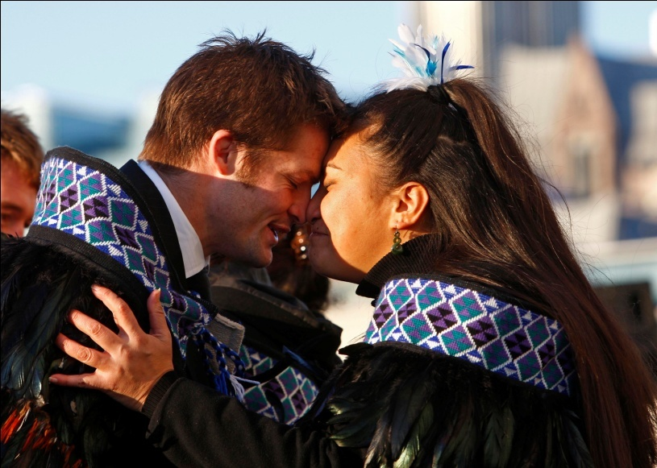
Te Mana i Waitangi
Human Rights and the Treaty of Waitangi
“A promise of two peoples to take the best possible care of each other.” – Bishop Bennett

Slide 9
Te Mana i Waitangi
The Treaty of Waitangi established a set of rights and obligations and a relationship between the Crown and Rangatira which remains in place today. It created a governance framework for the nation (kāwanatanga), affirmed the existing rights of Tangata Whenua (people of the land) (rangatiratanga) and guaranteed shared citizenship and equal rights for all (rite tahi).
The Treaty has been described as:
“The promise of two peoples to take the
best possible care of each other.”
The human rights dimensions of the Treaty of Waitangi include
both universal human rights and indigenous rights.
Human Rights Commission, Statement of Intent 2009-2010

Slide 10
Fast Forward 20th Century : Waitangi Tribunal
Waitangi Tribunal established in 1975 and makes recommendations on claims by Māori relating to legislation, policies, actions or omissions of the Crown (New Zealand Government) that are alleged to breach the promises made in the Treaty of Waitangi.
In 1985 jurisdiction extended for claims back to 1840 (historical claims)
Principles of Treaty – partnership, protection, participation, good faith, loyalty and others.
Notes:
The Waitangi Tribunal is a standing commission of inquiry. It makes recommendations on claims brought by Māori relating to legislation, policies, actions or omissions of the Crown that are alleged to breach the promises made in the Treaty of Waitangi
Constituted in 1975 to hear contemporary claims – that the Crown is in breach in modern times
In 1985 jurisdiction extended for claims back to 1840 (historical claims)
Principles of Treaty – partnership, protection, participation, good faith, loyalty and others

Slide 11
Treaty of Waitangi Settlements
Since 1990 , around 75 iwi (tribes) in New Zealand have finalized Treaty of Waitangi settlements with the Crown ( New Zealand Government) .
A Treaty settlement is an agreement between the Crown ( New Zealand Government) and a Māori claimant group, usually an iwi, (tribe) to settle all that claimant group’s historical claims against the Crown.
The Treaty settlement is typically composed off historical accounts, an acknowledgement and apology, cultural redress and financial and commercial redress.
The Treaty of Waitangi Settlements highlight the significant differences in Māori and Western Perspectives of Accounting and Accountability.
Notes:
The Waitangi Tribunal is a standing commission of inquiry. It makes recommendations on claims
Constituted in 1975 to hear contemporary claims – that the Crown is in breach in modern times
In 1985 jurisdiction extended for claims back to 1840 (historical claims)
Principles of Treaty – partnership, protection, participation, good faith, loyalty and others
Since 1990, around 75 iwi in New Zealand have finalized Treaty settlements with the Crown. A Treaty settlement is an agreement between the Crown and a Maori claimant group, usually an iwi, to settle all that claimant group’s historical claims against the Crown. The Treaty settlement is typically composed of historical accounts, an acknowledgment and apology, cultural redress and financial and commercial redress

Slide 12
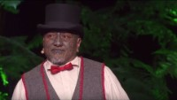
Mana : The power in knowing who you are: Tama Iti
Notes:
M

Slide 13
Māori Colonisation and an Interrupted History
There is a big difference between Māori and accounting and Māori accounting. Māori accounting is precisely that…it would be the accounting that Māori would do today and they did yesterday and all the years before throughout history if our development had been uninterrupted … to the extent that we had retained our repositories of knowledge.
… if you can say that the kind of accounting that Māori do today has a different history from the accounting that Māori would have done if they had an uninterrupted history … a less disturbing and devastating history then you’ve got two different things..
… you have two different possible pathways so you know what the question is … the question is “How are Māori performing these new accounting? or this post capitalist accounting? And if you are looking at that then its fine. (Barrett 2005)

Slide 14
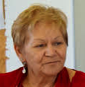
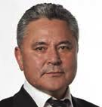


An Integrated Development Agenda: Panel Discussion
‘Aotearoa has an opportunity to become world leader in integrated development.’
‘The power of the State sector sets terms for economic engagement. The transfer of resources into Maori hands should be a goal so that realities can be properly addressed’
‘We now need to address the context of society of which political decision making is a dominant part. And a second dimension is the machinery of Government. Understanding both will be essential if progress is to be made.’
Naida Glavish
John Tamihere
Chair
Professor
Jarod Haar
Sir Wira Gardiner

Slide 15
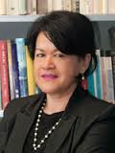
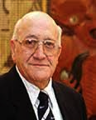
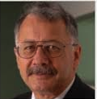
Te Pae Roa Confernce 2014
Massey University (Albany)
Māori economic growth saw the establishment of a number of entities including MANA, FOMA and MTV; but the vital question for the future will relate to the common good & opportunities for whānau
‘The real question is how Iwi see their futures without a grievance that can distort the vision’. ‘We need to be clear about designing a world that we want- a world that will be home to our mokopuna and their children.’
Ripeka Evans
Sir Tipene
O’Regan
Chair
Robin Hapi

Slide 16
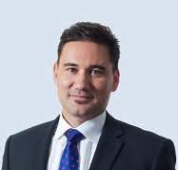

The Intergenerational Challenge: Balancing Present & Future Needs -
‘Guardians of the future against claims of the present’
Can be over- enthralled by our past rather than being fully involved in our future
A shift is occurring; collaborative v adversarial
An increasing asset base & decreasing wellbeing
80% Maori land is under-utilised – requires investments to increase the value & leadership
Māori Inc + NZ Inc = Aotearoa Inc
Te Tumu Paeroa Mission
‘Mobilising Māori land and assets to create this generation’s legacy’
Key Note
Speaker
Jamie Tuuta
Chair
Assoc.Prof.
Helen
Moewaka Barnes

Slide 17
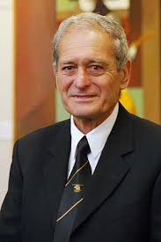
Māori Leadership what is the future we seek?
  All Māori thriving as Māori
  Flourishing whānau
  Forward looking and globally connected iwi
  Strong & vibrant te reo Māori, tikanga, and marae
  A booming Māori economy
  A regenerated natural environment
  Rebalanced constitutional arrangements in Aotearoa NZ
  (Te Pae Roa Conference 2014)

Slide 18
Connecting People with their land: Te Tumu Paeroa
https:////www.tetumupaeroa.co.nz
Notes:
Te Tumu Paeroa is an independent, professional trustee organisation which protects and grows the assets of Māori landowners. Te Tumu Paeroa administers 2000 trusts, companies and joint ventures on behalf of beneficial land owners, with a portfolio of 100,000 hectares nationwide of Māori freehold land and $80 million of client funds under management. One of Te Tumu Paeroa's core aims is to support owners to achieve higher aspirations for their land and assets and to create a legacy that delivers lasting benefit to the generations of the future. Te Tumu Paeroa has a focus on developing and collaborating on innovative and pragmatic solutions to the challenges of growing Māori assets to realise the benefits not only for owners, but the wider Māori and New Zealand economy.

Slide 19
Te Tumu Paeroa (2021)
              We face the dilemma of a growing asset base without increased overall well-being for Maori
              When balancing present and future needs we need to consider:
                The quadruple bottom line – financial, environmental, cultural and social
                The aspirations of this generation, and the legacy we want to leave
                Investment in our capability – workforce education, management and governance
                Increased collaboration among Maori and non Maori – skills, capital, partnerships
                The role of leadership

Slide 20
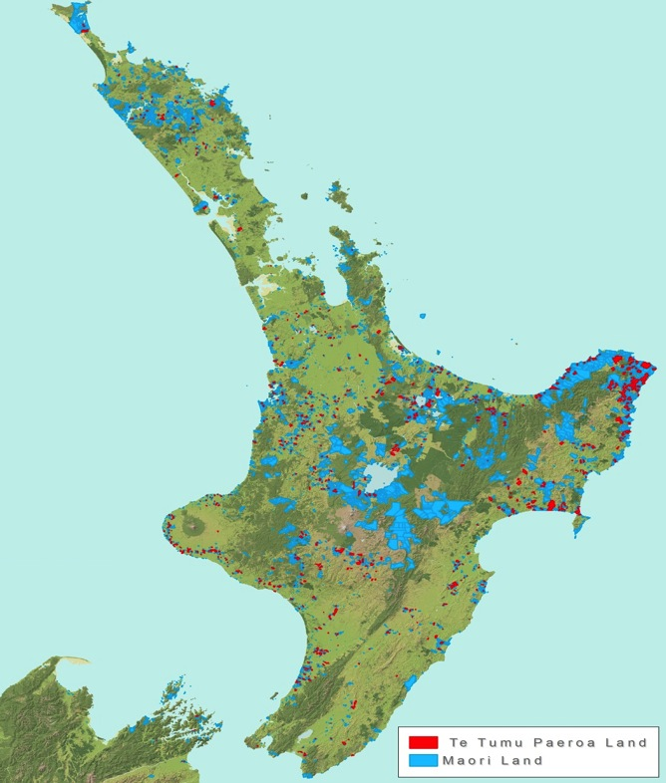
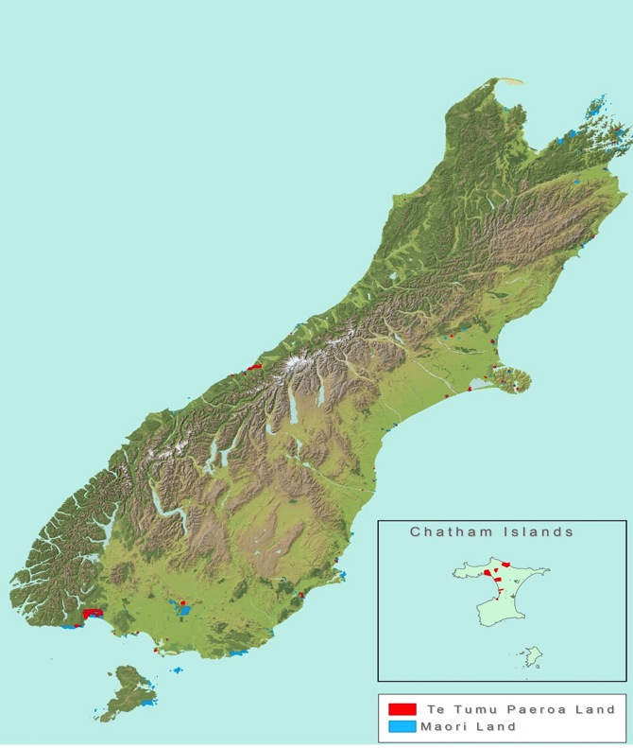
1.5 million hectares Māori land
5.5% of NZ total land mass

Slide 21
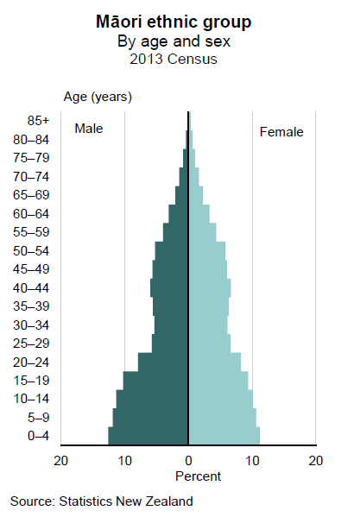
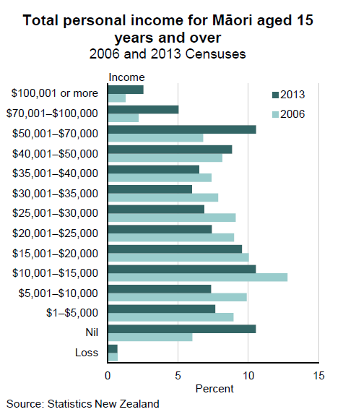
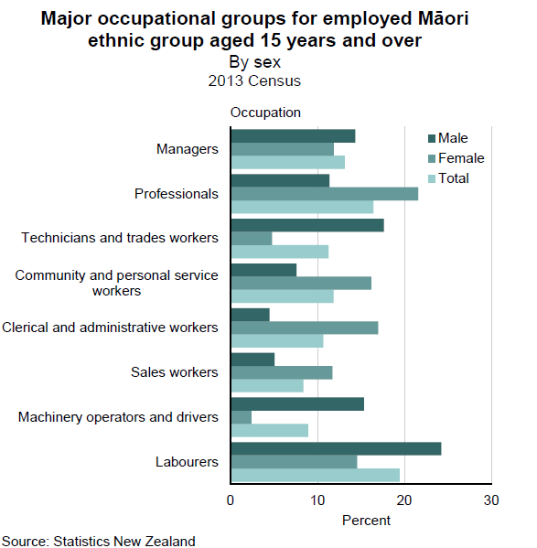
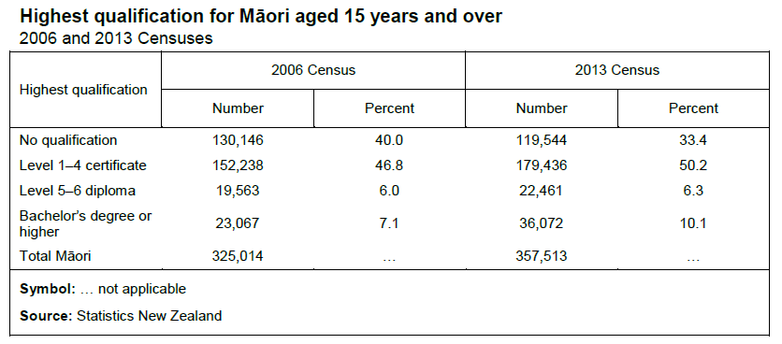
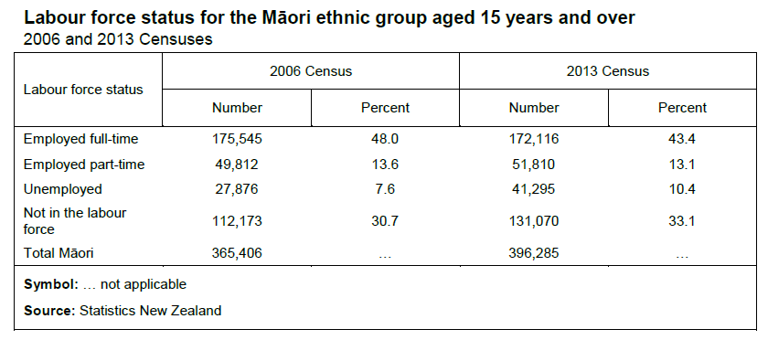
Understanding the Māori demographic
$10.6bn
Institutions
$5.4bn
Self-employed
2006
$16.4bn
(estimate)
$20.8bn
Employers

Slide 22
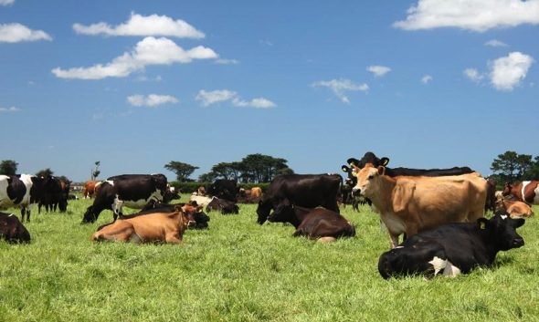
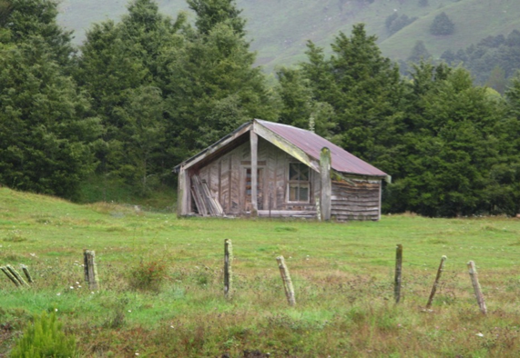
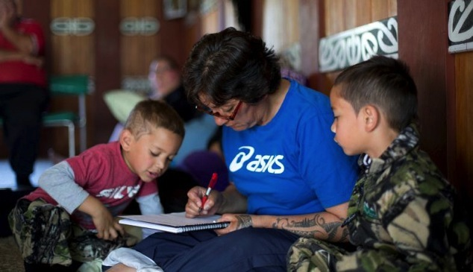
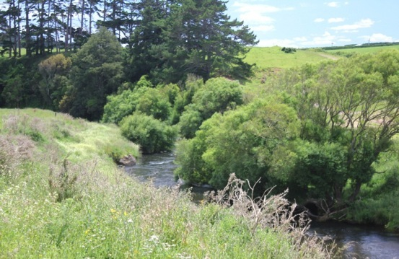
Reframing success (Te Tumu Paeroa 2021)
Economic
Cultural
Social
Environmental

Slide 23
Reframing success (Te Tumu Paeroa 2021)
Economic
Cultural
Social
Environmental

Slide 24
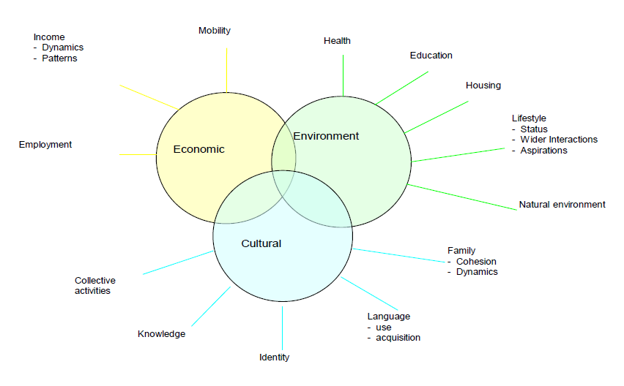
Reframing Māori Success
Cultural
Social
Notes:
The interaction between economic, environment and cultural/social wellbeing. They are mutually dependent, and can prove to a positive or negative reinforcement of one another. Cultures have come and gone through the ages due to both rising and then declining economic and or environmental sustainability.
Economic Prosperity and Growth
Combining people, knowledge, and physical and financial resources enables economic activity and ‘wealth’ to be created. The means by which sustainable economic growth can be created are by either:
A) Putting more resources into economic use e.g.,
• More people joining the labour force e.g., young, new migrants, or previously unemployed, or • Increasing the level of technology or capital per person (e.g., digging with shovels not hands), or • More land or resources being put into economic use.
B) Using the same resources more efficiently (smarter) e.g.,
• Finding new ways of utilising the same inputs, • Using new technologies to improve information sharing (e.g., computers) • Applying science or new work systems to previous means of manufacturing or processing.

Slide 25
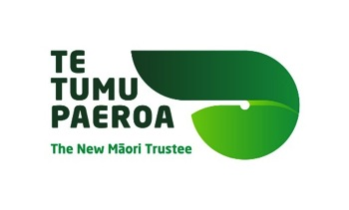
Maori Asset Ownership Objectives
              Perpetual (taonga) Assets vs other assets
              How to avoid commercial or environmental outcomes where involuntary loss of ownership and control occurs
              Appropriate risk and management processes
              Does perpetual ownership and control over certain assets is a Maori objective that shapes attitudes and behaviour of Maori owners in a way that is significantly different from the norm.
Notes:
‘Taonga’ assets are those things that Maori would like to bequeath to future generations. In contrast, ‘other’ assets are essentially a current means to a current end, namely the generation of earnings. As such they are a function of the enterprise or enterprises to which the ‘taonga’ capital assets are currently committed and will be bought and sold without undue compunction as the needs of the enterprise or enterprise mix evolve over time.
For some, perpetual land ownership is the most important consideration and the enterprises carried out on that land comes second and can change over time (perpetuity).

Slide 26
TAONGA TUKU IHO
              My tikanga is that kin owned assets are taonga (treasures) part of an inter generational legacy that are passed by the ancestors. …
              These are taonga tuku iho- which means they don’t belong to us, they go on and on, we pass from one generation to the next and our job in our generation is to protect them for the next generation … (Barrett 2005)
              e.g. our lakes and rivers and mountains.

Slide 27

Emergence Integrated Reporting?

Slide 28
Why Integrated Reporting?
Company paradigm created in era of industrial revolution does not explain all forms of capital value.
Today stakeholders demand information about all forms of capital in making financial investment and valuation decisions.
Important to remember that IR capitals do not replace financial capital but add financial and non financial information.

Slide 29

<IR>: A new focus
Interview with Professor Carol Adam
https://www.youtube.com/watch?v=giKGVMM8Z5Y
Notes:
<IR> is consistent with developments in financial and other reporting, but an integrated report also differs from other reports and communications in a number of ways. In particular, it focuses on the ability of an organization to create value in the short, medium and long term, and in so doing it:
is a concise communication about how an organization’s strategy, governance, performance and prospects, in the context of its external environment, lead to the creation of value over the short, medium and long term.
Has a combined emphasis on conciseness, strategic focus and future orientation, the connectivity of information, and the capitals and their interdependencies
Emphasizes the importance of integrated thinking within the organization.

Slide 30
<IR>: A new focus
concise communication about value
strategy, governance,
performance, prospects
Other
reporting
Financial
reporting
Notes:
<

Slide 31
What is <IR>?
Integrated thinking
Integrated reporting
Integrated report
Notes:
Integrated Reporting <IR>: A process founded on integrated thinking that results in a periodic integrated report by an organization about value
creation over time and related communications regarding aspects of value creation.
Integrated report: A concise communication about how an organization’s strategy, governance, performance and prospects, in the context of its external environment, lead to the creation of value in the short, medium and long term.
Integrated thinking: The active consideration by an organization of the relationships between its various operating and functional units and the capitals that the organization uses or affects. Integrated thinking leads to integrated decision-making and actions that consider the creation of value over the short, medium and long term.

Slide 32
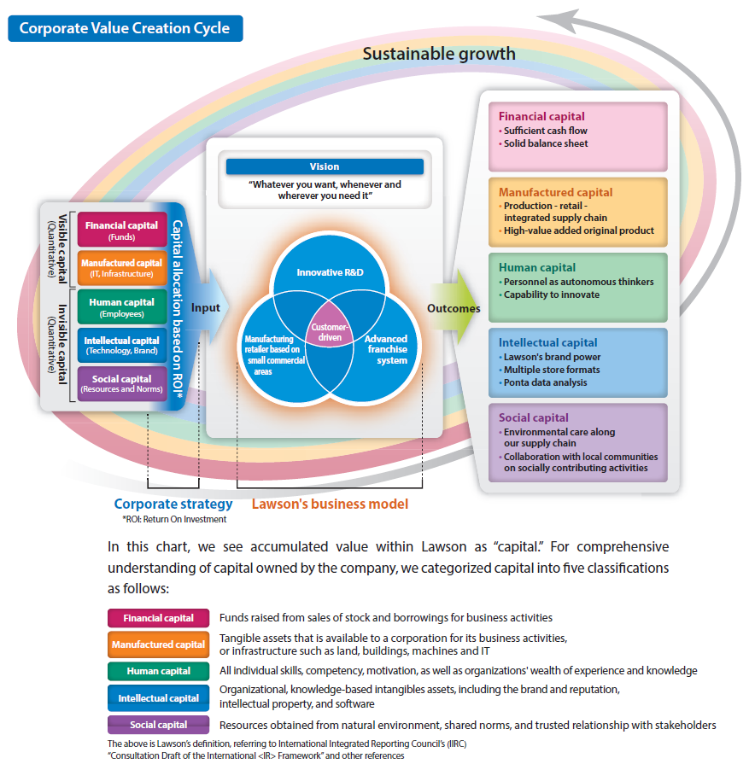
Lawson, Inc. Integrated Report 2013
Notes:
Lawson introduces its business model in the section of “Message from CEO” as a basis for the discussion on how to achieve management’s commitment, 20% of Return on Equity (ROE). The content is clear, concise and logically structured.
The explanation on Lawson’s advantage is followed by this diagram. The vision is based on the customer-driven corporate culture, and is positioned in centre place. Three components are identified as a differentiator and a viable driver of its business model.
Each component is explained in the following pages, demonstrating its interaction with each other. Capitals shown in the diagram are further explained in the narrative part to supplement information in the diagram.

Slide 33
Corporate social responsibility (CSR)
Responsibilities of corporations as social institutions
Five main aspects have been identified:
  Broad social implications (global warming, poverty reduction)
  Economic benefits related to social and environmental performance
  Business attitudes, awareness, and practices
  Implications for non-business stakeholders
  Awareness of corporate responsibility
CSR has been shown to have a positive effect on banking sector, systematic risk, and customer loyalty

Slide 34
What are ESG dimensions?
Developed by MSCI (Morgan Stanley Capital International)
E is for Environmental
  Climate change (carbon emissions, energy efficiency)
  Natural capital (water stress, biodiversity and land use)
  Pollution and waste (toxic emissions)
  Environmental opportunities (opportunities in clean tech, renewable energy)

Slide 35
ESG: dimensions - continued
S is for Social
  Human Capital (health and safety, supply chain labour standards)
  Product liability (product safety and quality, responsible investment)
  Stakeholder opportunities (controversial sourcing)
  Social opportunities (access to finance, healthcare, communications)
G is for Governance
  Corporate governance (board, pay, ownership and control, accounting)
  Corporate behaviour (business ethics, anticompetitive practices, corruption)

Slide 36
Barriers to implementation of integrating reporting
Integrated Reporting is likely to require cultural and organizational change.(Robertson & Samy, 2015)
Adams (2013) argues that Integrated Reporting (IR) requires a fundamental shift and a different way of thinking about what makes an organisation successful.
Example:
For Māori Businesses , the concern is to link the Integrated Development Agenda with Integrated Reporting

Slide 37
Conclusion
Māori Businesses have a Māori Worldview
Māori Businesses do not only measure success on the dollar value
Māori Businesses are kaitiaki (guardians) to kin owned assets (taonga tuku iho) that they must be looked after and pass on to the next generation to care for.

Slide 38
Further Recommended Readings
Adams, C. A. (2015). The International Integrated Reporting Council: A call to action. Critical Perspectives on Accounting, 27, 23-28. https://doi.org/10.1016/j.cpa.2014.07.001
Adams. C. Sustainable Reporting https://drcaroladams.net/category/accounting/ (Link)
Barrett, M. (2005). Accounting and Accountability in Maori Organisations in Aotearoa New Zealand (PhD ), Glasgow Caledonian University United Kingdom.
de Villiers, C., & Sharma, U. (2017). A critical reflection on the future of financial, intellectual capital, sustainability and integrated reporting. Critical Perspectives on Accounting https://doi.org/10.1016/j.cpa.2017.05.003
Lawson Report. (2013). Integrated Report "Creating Happiness and Harmony in our Community ". Retrieved from http://lawson.jp/en/ir/library/pdf/annual_report/ar_2013_e.pdf
Robertson, F., & Samy, M. (2015). Robertson, F and Samy, M (2015) Factors affecting the diffusion of integrated reporting – A UK FTSE 100 perspective. Sustainability Accounting, Management and Policy Journal, Vol. 6, Issue 2 (Vol. Vol. 6).
Te Tumu Paeroa (2014) https://www.tetumupaeroa.co.nz (Link)
Winiata, W. (2011) Te Whare Wananga o Raukawa ,Otaki (Presentation)

Slide 39
Further Video Links
A clip about Kono, a diverse food-based Māori enterprise located in the top of the South Island and their approach to management of this business with Pat Stafford
https://www.youtube.com/watch?list=PL3mRXtJm5KyaF0p6hAQo_59Rcq7NA4vFn&time_continue=26&v=dDrUQz9SPbI
. Massey Business School Dr Jason Mika Māori World View
https://www.youtube.com/watch?v=2GHlwR8BztA

